Slide 1
Organization : Councilor Ruthzee Louijeune
Team Members : Yuesi Liu / Haoran Yang / Shun Yao / Hanlin Zou
Lecturer: Hanlin Zou
Landlord Mapping
(Small Landlord Data Analysis)

Slide 2
Project Introduction
Project motivation
Help people with lower income to find suitable housing
2. Goal
Create a connection between affordable housing units to qualified tenants.
3. Background
Basic knowledge of Data Science techniques and sense of urban infrastructure.

Slide 3
Labor division and data preparation
Yuesi Liu/Haoran Yang:
Data Cleaning
Landlords and Housing analysis
Housing stock analysis
Shun Yao/Hanlin Zou:
Partial Data Cleaning
NOT-enrolled Landlords analysis
wrapping up
Dataset Used:
BostonAssessorsDataCleaned.csv
income-restricted-inventory-2021.csv
boston-neighborhood-data.csv
2. Using Google API to obtain the detailed addresses from income-restricted dataset.
3. Clean data from step 2 to obtain new attributes and merge with BostonAssessor Dataset.

Slide 4
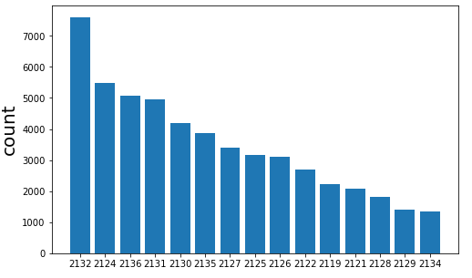
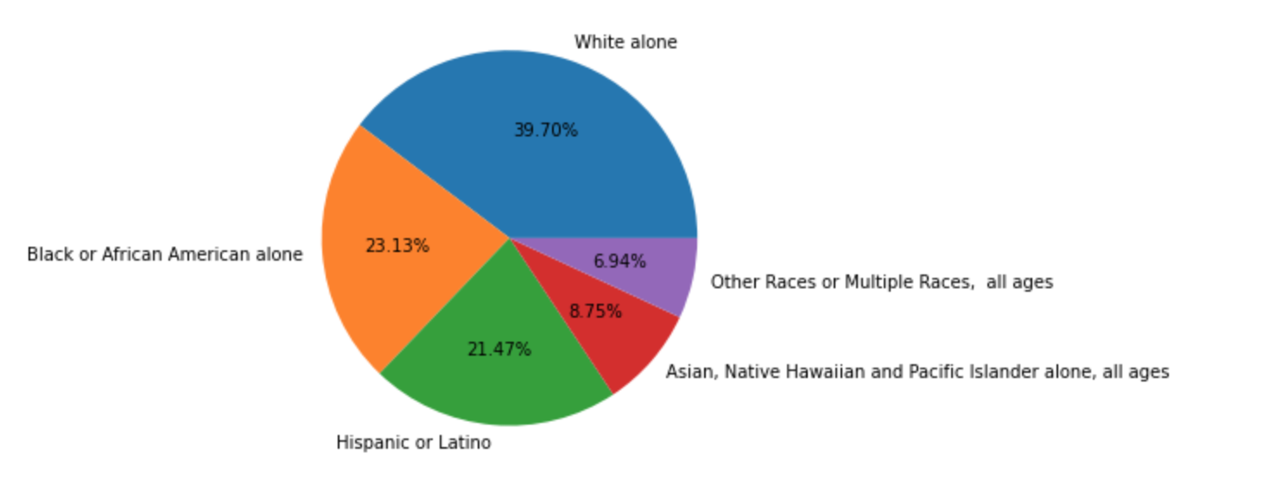
Result
Base Question 1:
# of units are NOT enrolled in any programs: 19304
Most NOT-enrolled landlords zip code: 02132
In terms of race distribution, top 3 majority races are: White(39.70%), Black or African American(23.13%) and Hispanic or Latino(21.47%)

Slide 5
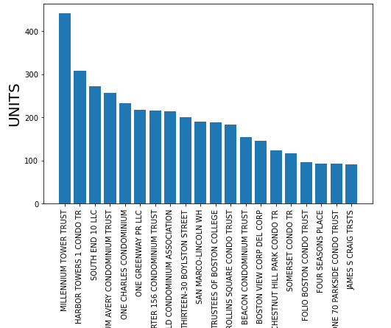
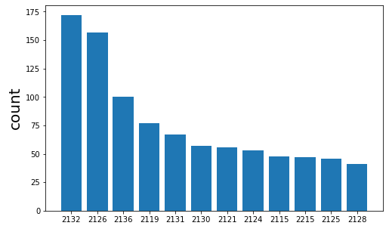
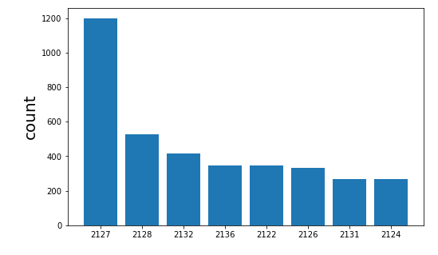
Result
Base Question 2:
In affordable housing, Millennium Tower Trust is the landlord that has the most available units.
Most landlords zip code: 02132
Most housing: 02127

Slide 6
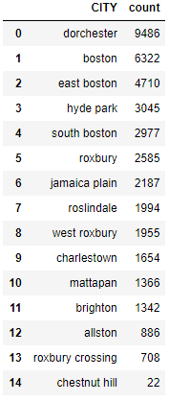
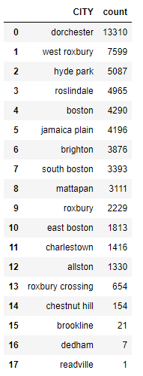
Result
Affordable
Non-affordable
Base Question 3:
Dorchester city has the most affordable housing and non affordable housing

Slide 7
Result
Base Question 4:
Owner occupied and small landlords: 75.91%
Other: 24.09%
2. Affordable Owner occupied and small landlords: 36.27%
Non-Affordable: 64.53%

Slide 8
Challenge when dealing with data
In the process of getting a detailed address through google api, the process of splitting the address is very complicated.
2. The process of obtaining affordable house longitude and latitude takes too long

Slide 9
Challenge / Limitation / Assumption
Not familiar with the zip code and street names in the Boston area. So we don't have a very intuitive sense of the data
2. We cannot find ratios of each race living in affordable housing and non affordable housing
3. We suspect that the addresses we get from google api are not only located in boston, but also some other cities like NYC share the same street addresses.

Slide 10
Next step
Re-evaluate what we have obtained and move on to the extension part.
2. Make a feasible plan and complete before deadline.

